Slide 1
Decision Tree (DT)
A decision tree (DT) is a supervised learning algorithm used for both classification and regression tasks.
It can be used to predict categorical outcomes (classification) or continuous values (regression).
Classification example: Classify emails as spam or not spam, or to identify different types of flowers based on their characteristics.
Regression example: Predicting house prices or stock market trends.

Slide 2
Decision Tree Classifier
Decision tree classifier is a hierarchical tree structure that is used to classify classes based on a series of questions (or rules) about the attributes of the class.
Attributes can be of any type:
  Binary (0 or 1)
  Nominal (Hair color: Black, Brown, Red)
  Ordinal (Rank: 1, 2, 3)
  Quantitative values (Salary: 5K, 10K, 21K)
Classes must be qualitative type (binary or categorical)
So, given a data of attributes along with its classes, a decision tree produces a sequence of rules that can be used to identify the class.

Slide 3
Decision Tree Classifier
The goal of decision tree classifier is to build a model using the training data to classify examples in one of the multi–class target.
Decision tree algorithm constructs a tree consisting of two types of nodes: internal nodes and leaf nodes.
Root and internal nodes of DT represent attributes/features of data, while leaf nodes represent the class label.

Slide 4
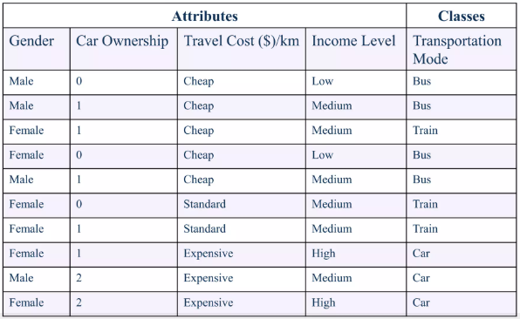
Decision Tree Example
Let's say you are given a data with attributes Gender, Car ownership, travel cost, and income level, and you want to decide based on these attributes which transportation mode to use: Bus, Train or Car

Slide 5
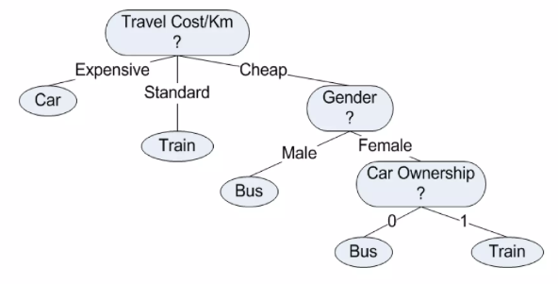
Decision Tree Example
Let’s say DT algo build this tree.
Now, using this tree, we can apply on test data and answer some questions.

Slide 6
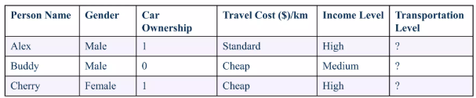
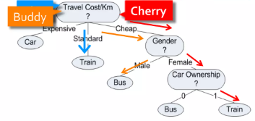
Decision Tree Example
Test Data
What transportation mode would Alex, Buddy and Cherry use?

Slide 7
Decision Tree Algorithms
In order to learn the representation (tree), we need an algorithm.
Decision Tree Algorithms:
ID3 (1986 ; Ross Quinlan)
C4.5 (1993; Ross Quinlan)
CART (1984; Breimanetal)

Slide 8
Basic Decision Tree Algorithm
Let S be the set of Examples
  Label is the target attribute (the prediction)
  Attributes is the set of measured attributes
ID3(S, Attributes, Label)
If all examples are labeled the same return a single node tree with Label
Otherwise Begin
A = attribute in Attributes that best classifies S (Create a Root node for tree)
for each possible value v of A
Add a new tree branch corresponding to A=v
Let Sv be the subset of examples in S with A=v
if Sv is empty: add leaf node with the common value of Label in S
Else: below this branch add the subtree
ID3(Sv, Attributes - {a}, Label)
End
Return Root

Slide 9
Decision Tree Induction
Decision Tree contains internal nodes and leaf nodes.
Internal nodes have one of the attributes and Leaf nodes have label/target values.
Greedy strategy: Split the records based on an attribute test that optimizes certain criterion.
Steps in DT induction:
Determine the node attribute
  Specify the attribute test condition
  Selection of best attribute
Stop Criteria

Slide 10
Attribute Test Conditions
Depending upon attribute type and number of ways to split, we can have variety of test conditions at each internal node.
Nominal attributes
Multi-way split: Use as many partitions as distinct values
CarType
Family
Luxury
Sports
Binary split: Divides values into two subsets
CarType
CarType
{Sports, Luxury}
{Family}
{Family,
Luxury}
{Sports}

Slide 11
Attribute Test Conditions
Ordinal attributes
Multi-way split: Use as many partitions as distinct values
Size
Small
Large
Medium
Binary split: Divides values into two subsets
{Medium,
Large}
Size
Size
{Small}
{Small, Medium}
{Large}

Slide 12
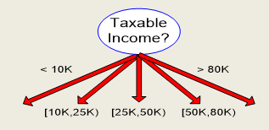
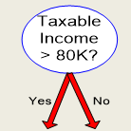
Attribute Test Conditions
Continuous attributes
Multi-way split: Ranges are divided into equal interval buckets
Binary split: Find the best cut
(A < v) or (A > v)

Slide 13
Picking the Root attribute
The goal is to have the resulting decision tree as small as possible (Occam’s Razor)
  But, finding the minimal decision tree consistent with the data is NP-hard
The recursive algorithm is a greedy heuristic search for a simple tree, but cannot guarantee optimality.
The main decision in the algorithm is the selection of the next attribute to condition on.

Slide 14
Picking the Root attribute
Nodes with homogeneous class distribution are preferred
Need a measure of node impurity:
Non-homogeneous,
High degree of impurity
Homogeneous,
Low degree of impurity

Slide 15
Measures for Node impurity
Information Gain
Gini Index

Slide 16
Information Gain
Which split is more informative?
Less than 50k Equal to or over 50k
Employed Unemployed

Slide 17
Information Gain
Information Gain is calculated using entropy.
Entropy: measures the level of impurity/disorder/uncertainity in a group.

Slide 18
Information Gain
Entropy
S is a sample of training examples
p+ : is the proportion of positive examples in S
p- : is the proportion of negative examples in S
Entropy of S: average optimal number of bits to encode information of certainty/uncertainty about S.
Entropy(S) = p+ (-log2 p+ ) + p-(-log2 p-)

Slide 19
Information Gain
Entropy of a group in which all examples belong to the same class?
Entropy = - 1 log₂(1) = 0 Minimum impurity
Entropy of a group with 50% in either class?
Entropy = -0.5 log₂(0.5) – 0.5 log₂(0.5) =1 Maximum impurity

Slide 20
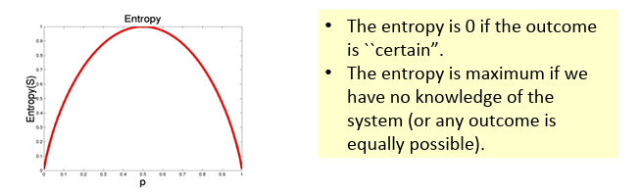
Information Gain

Slide 21
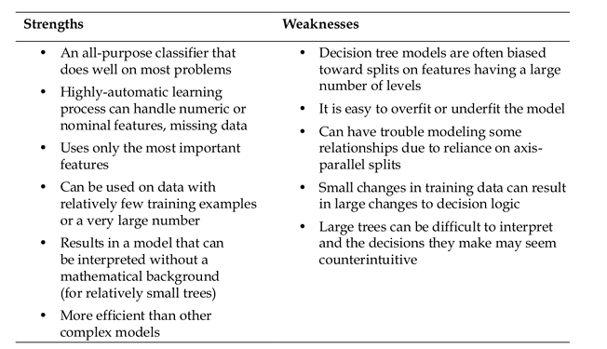
Decision Tree

